Slide 1
Dynamic Programming

Slide 2

Outline
Introduction
The Principle of optimality
Problem Solving using Dynamic Programming – Calculating the Binomial Coefficient
Making Change Problem
Knapsack Problem
Assembly Line-Scheduling
All Points Shortest Path
Matrix Chain Multiplication
Longest Common Subsequence
Looping

Slide 3
Introduction

Slide 4
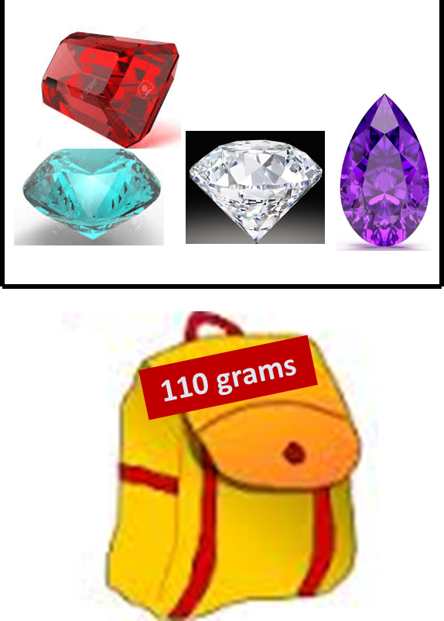
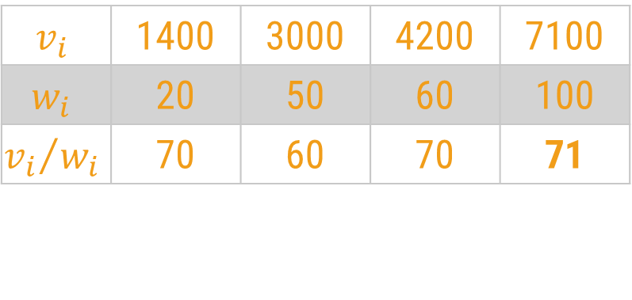
Introduction
A box contains 4 stones worth $1400, $3000, $4200 and $7100. They weigh 20, 50, 60 and 100 grams respectively.
Your bag can only hold 110 grams.
Greedy Approach
The greedy algorithm selects the best candidate with the highest profit, i.e., stone worth $7100.
$$v_{i}$$ | 1400 | 3000 | 4200 | 7100
$$w_{i}$$ | 20 | 50 | 60 | 100
$${v_{i}}/{w_{i}}$$ | 70 | 60 | 70 | 71

Slide 5
Introduction
A box contains 4 stones worth $1400, $3000, $4200 and $7100. They weigh 20, 50, 60 and 100 grams respectively.
Your bag can only hold 110 grams.
But, the optimal choice would be to select the two stones worth $3000 and $4200.
Their combined weight is 110 grams, which means they will fit into your bag and you will get a profit of $7200.
If there are 100 stones, how to efficiently find the optimal answer?

Slide 6
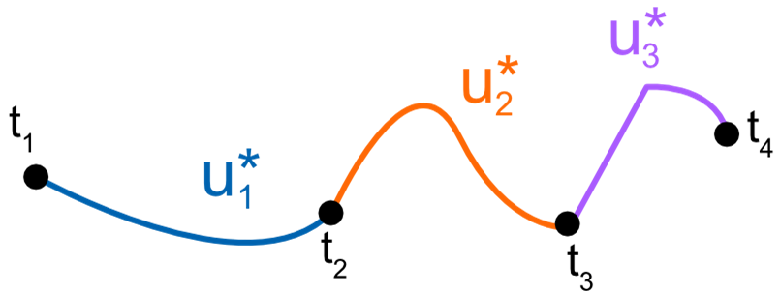
The Principle of Optimality
A dynamic-programming algorithm solves every sub-problem just once and then saves its answer in a table.
It avoids the work of re-computing the answer every time the sub problem is encountered.
The dynamic programming algorithm obtains the solution using principle of optimality.
The principle of optimality states that “in an optimal sequence of decisions or choices, each subsequence must also be optimal.
If it is not possible to apply the principle of optimality then it is almost impossible to obtain the solution using the dynamic programming approach.

Slide 7
Dynamic Programming:
Dynamic programming is a technique to solve the recursive problems in more efficient manner.
Many times in recursion we solve the sub-problems repeatedly.
In dynamic programming we store the solution of these sub-problems so that we do not have to solve them again, this is called Memoization.
Dynamic programming and memoization works together. So Most of the problems are solved with two components of dynamic programming (DP)-
Recursion – Solve the sub-problems recursively
Memoization – Store the solution of these sub-problems so that we do not have to solve them again
In recursion, we also break a problem into similar subproblems. The difference is in recursion similar subproblems may be solved multiple times. But in dynamic programming, we keep track of already solved subproblems and don’t solve them more than once. The problems that appear multiple times are called overlapping subproblems. To solve a problem in dynamic programming style we save the solutions of overlapping subproblems in a data structure. This is known as “Memoization”.

Slide 8
Fibonacci of a Number

Slide 9
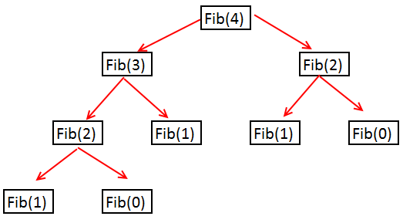
Fibonacci Series
The Fibonacci Series is a sequence of integers where the next integer in the series is the sum of the previous two.
In mathematical terms, the sequence Fib(n) of Fibonacci numbers is defined by the recurrence relation.
Fib(n) = Fib(n-1) + Fib(n-2), With seed value: Fib(0)=0, Fib(1)=1
Problem statement: Given a number n, find n^{th} Fibonacci Number.

Slide 10
Recursive Fibonacci
int fib(n):
if n == 0:
return 0
if n == 1:
return 1
return fib(n - 1) + fib(n - 2)
Time Complexity: T(n) = T(n-1) + T(n-2) + 1 = O(2^{n})
We can solve a problem using dynamic programming if the problem has the following attributes:
Optimal sub-problems: We can break a larger problem into similar sub-problems. If we can solve the sub-problems optimally we can use them to solve the main problem.
Overlapping sub-problems: The recursive solution to the problem contains sub-problems that are repeated multiple times.

Slide 11
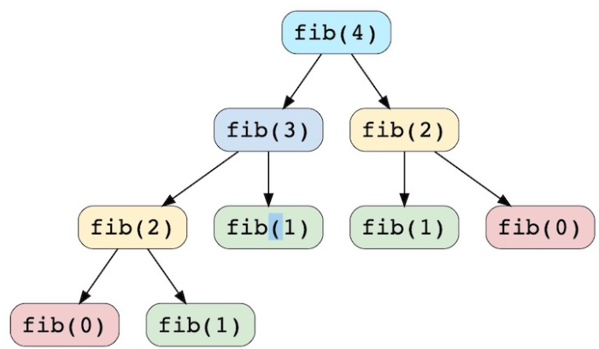
It is computing the same Fibonacci numbers multiple times in order to get our solution.

Slide 12
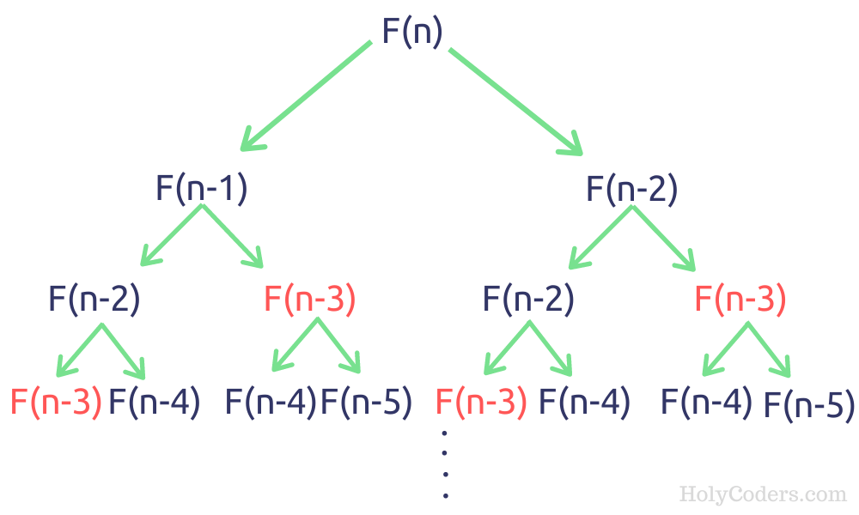

Slide 13
Dynamic Programming Approach
We can store the results of previously solved sub-problems in a data structure like a list.
And the function fib() will check if a sub-problem is already solved or not.
If solved before we will not solve it again.
Let’s take a list memo[ ].
Once a sub-problem is solved we will store the solution in memo[ ]. Saving the solutions like this is called memoization.

Slide 14
Dynamic Approach
int fib(n):
if n == 0:
return 0
if n == 1:
return 1
if memo[n] != -1:
return memo[n]
memo[n] = fib(n-1) + fib(n-2)
return memo[n]
Now for fib(n) we need to check if memo[n] is equal to -1 or not.
If it is -1 then we can say that the problem was not solved before and we will solve it.
But if it is other than -1 then we can say that the problem was solved before. So we don’t have to solve it again. We will just return it.

Slide 15
Comparing the Complexity(Recursive vs DP)
In the recursive approach for every value from 0 to n two functions are called (except the base cases).
For example, fib(6) is calling fib(5) and fib(4). Then fib(5) is calling fib(4) and fib(3). Again fib(4) is calling fib(3) and fib(2) and so on. So the time complexity of the recursive approach is O(2^{n}).
In the dynamic programming approach, we are solving a sub-problem once.
For fib(n) we have total n sub-problems — fib(0), fib(1), fib(2) … fib(n).
And we are solving each one of them just once. So the time complexity for the dynamic approach is O(n). It is a linear complexity. Which is a huge improvement from the recursive approach.

Slide 16
Iterative solution(bottom-up )
int fib(n):
memo[0] = 0
memo[1] = 1
for i : 2 to n+1
memo[i] = memo[i-1] + memo[i-2]
return memo[n]

Slide 17
Binomial Coefficient

Slide 18
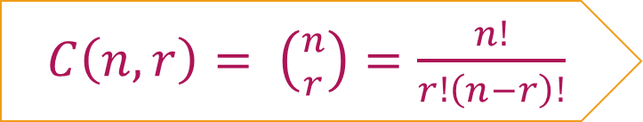
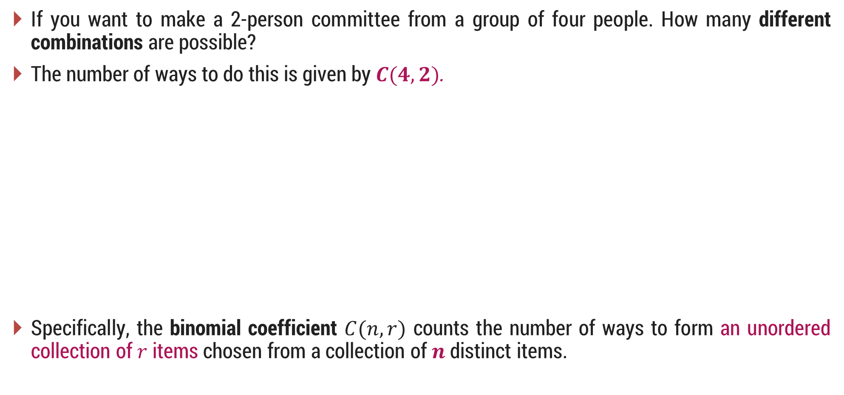
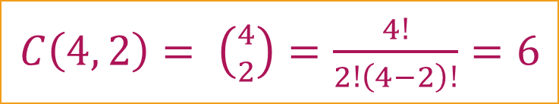
Introduction
If you want to make a 2-person committee from a group of four people. How many different combinations are possible?
The number of ways to do this is given by $C(4, 2)$.
Specifically, the binomial coefficient $C(n, r)$ counts the number of ways to form an unordered collection of $r$ items chosen from a collection of $n$ distinct items.
Consider 4 people A, B, C, D. Now the different combinations for making a committee of 2 persons from these 4 are;
A, B
A, C
A, D
C, D
B, D
B, C
$C\left(n,r\right)= \left({n \atop r}\right)=\frac{n!}{r!\left(n−r\right)!}$
$C\left(4, 2\right)= \left({4 \atop 2}\right)=\frac{4!}{2!\left(4−2\right)!}=6$

Slide 19
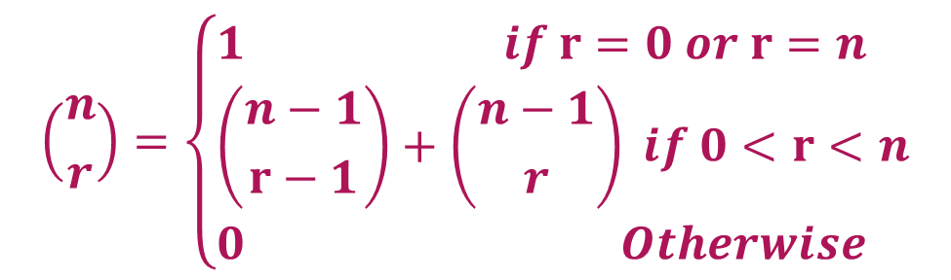
Binomial Coefficient
The definition of binomial coefficient is given as:
$$\left({n \atop r}\right)=\left\{\begin{aligned}&1 if r=0 or r=n \\ &\left({n−1 \atop r−1}\right)+\left({n−1 \atop r}\right) if 0<r<n \\ &0 Otherwise\end{aligned}\right.$$
function C(n, r)
if r=0 or r=n then return 1
else return C(n-1, r-1) + C(n-1, r)

Slide 20
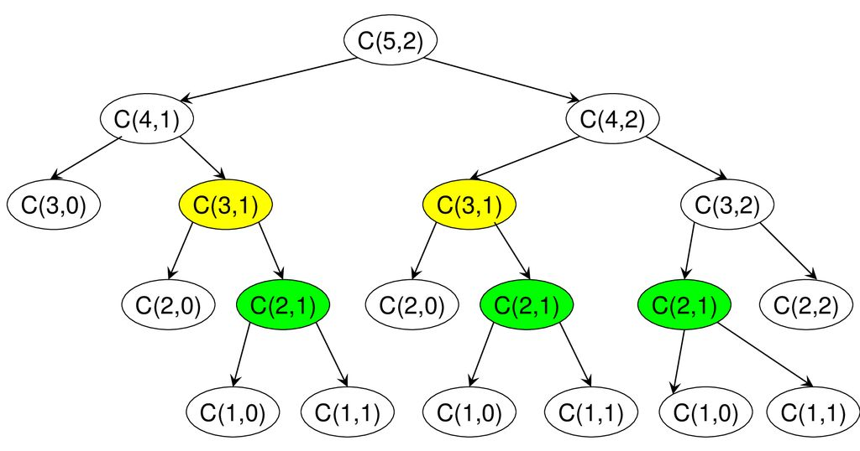
Recursion tree for C(5,2)
1) Optimal Substructure
The value of C(n, r) can be recursively calculated using the following standard formula for Binomial Coefficients.
C(n, r) = C(n-1, r-1) + C(n-1, r)
C(n, 0) = C(n, n) = 1
2) Overlapping Sub-problems
It should be noted that the above function computes the same sub-problems again and again. See the following recursion tree for n = 5 an r = 2.
The function C(3, 1) is called two times. For large values of n, there will be many common sub-problems.

Slide 21
Binomial Coefficient
 | 0 | 1 | 2 | 3 | 4 | 5 | .. | r
0 | 1
1 | 1 | 1
2 | 1 | 2 | 1
3 | 1 | 3 | 3 | 1
4 | 1 | 4 | 6 | 4 | 1
..
n
+
+
+
+
+
+
PASCAL’s TRIANGLE
function C(n, r)
if r=0 or r=n then return 1
else return C(n-1, r-1) + C(n-1, r)

Slide 22
Time complexity(without Memoization)
int binomialCoeff(int n, int r)
{
// Base Cases
if (r > n)
return 0;
if (r == 0 || r == n)
return 1;
// Recur
return binomialCoeff(n - 1, r - 1) + binomialCoeff(n - 1, r);
}
int binomialCoeff(int n, int r)
{
int C[n + 1][r + 1];
int i, j;
// Calculate value of Binomial Coefficient
// in bottom up manner
for (i = 0; i <= n; i++)
for (j = 0; j <= min(i, r); j++)
{
if (j == 0 || j == i) // Base Cases
C[i][j] = 1;
else
C[i][j] = C[i - 1][j - 1] + C[i - 1][j];
}
return C[n][r];
}
Time complexity: O(n^{r})
Space complexity: O(n^{r})

Slide 23
Time complexity(with Memoization)
int binomialCoeffUtil(int n, int k, int** dp)
{
// If value in lookup table then return
if (dp[n][r] != -1) //
return dp[n][r];
// store value in a table before return
if (r == 0 || r == n)
{
dp[n][k] = 1;
return dp[n][r];
}
// save value in lookup table before return
dp[n][r] = binomialCoeffUtil(n - 1, r - 1, dp) + binomialCoeffUtil(n - 1, r, dp);
return dp[n][r];
}
Time Complexity: O(( min(r, n-r)²) * log(n))
Space Complexity: O(min(r, n-r))

Slide 24
Generalized Solution using Dynamic Programming
Characterize the structure of an optimal solution.
Recursively define the value of an optimal solution.
Compute the value of an optimal solution in a bottom-up fashion.
Construct an optimal solution from the computed information.

Slide 25
Coin Change Problem
Generate a change with minimum coin.
How many different ways we can generate change.

Slide 26
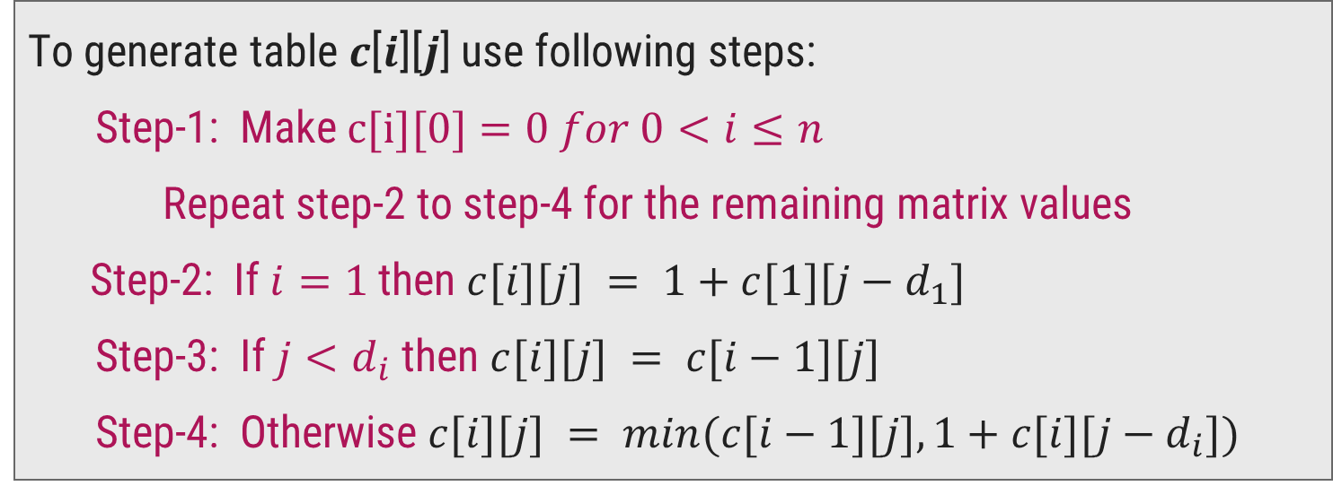
Make Change Problem1 – Dynamic Programming Solution
We need to generate a table 𝑐[𝑛][𝑁], where
𝑛 = number of denominations
𝑁= amount for which you need to make a change.
To generate table 𝒄[𝒊][𝒋] use following steps:
Step-1: Make $c[i][0]=0$𝑓𝑜𝑟 $0<i≤n$
Repeat step-2 to step-4 for the remaining matrix values
Step-2: If $i=1$then $c[i][j] = 1+c[1][j−d_{1}]$
Step-3: If $j<d_{i}$ then $c[i][j] = c[i−1][j]$
Step-4: Otherwise $c[i][j] = min⁡(c[i−1][j],1+c[i][j−d_{i}])$
Optimal
Sub-structure

Slide 27
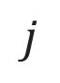
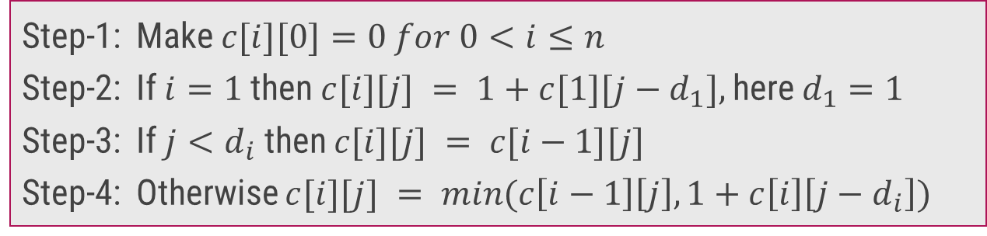
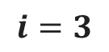
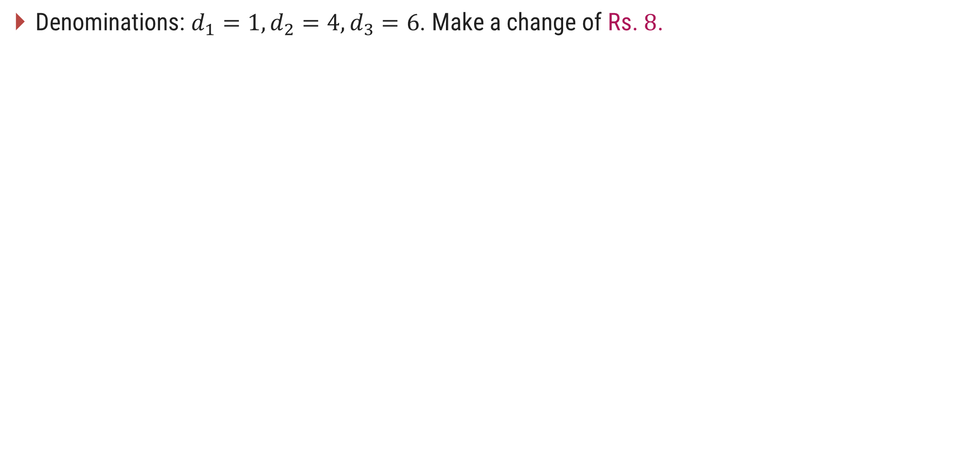
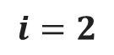
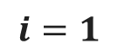
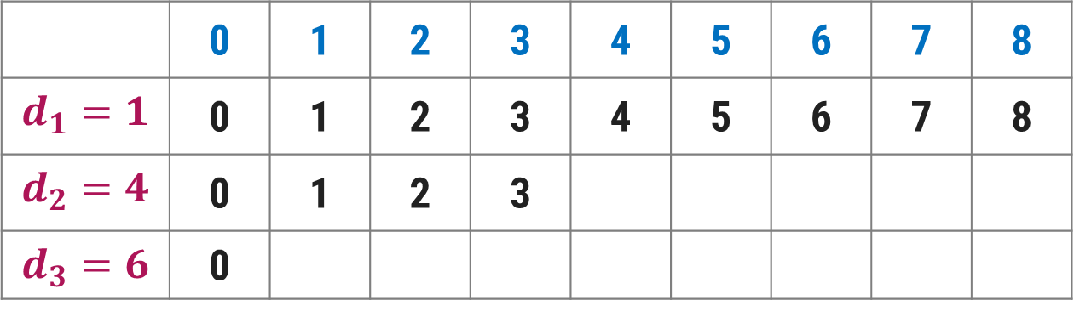
Make Change Problem1 – Dynamic Programming Solution
Denominations: $d_{1}=1, d_{2}=4, d_{3}=6$. Make a change of Rs. $8$.
Step-1: Make $c[i][0]=0 for 0<i≤n$
Step-2: If $i=1$then $c[i][j] = 1+c[1][j−d_{1}],$here $d_{1}=1$
Step-3: If $j<d_{i}$ then $c[i][j] = c[i−1][j]$
Step-4: Otherwise $c[i][j] = min(c\left[i−1\right]\left[j\right],1+c\left[i\right]\left[j−d_{i}\right])$
$$j$$
Amount
 | 0 | 1 | 2 | 3 | 4 | 5 | 6 | 7 | 8
$$d_{1}=1$$ | 0 | 1 | 2 | 3 | 4 | 5 | 6 | 7 | 8
$$d_{2}=4$$ | 0 | 1 | 2 | 3
$$d_{3}=6$$ | 0
$$i=1$$
$$i=2$$
1
2
$$i=3$$
$$min⁡(c[1][4],1+c[2][0])=min⁡(4,1+0)=min⁡(4,1)=1$$
$$min(c[1][5],1+c[2][1])=min(5,1+1)=min(5,2)=2$$

Slide 28
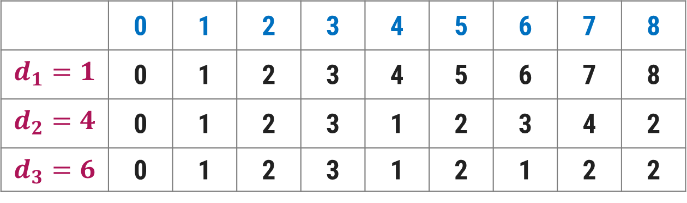
Make Change Problem1 – Dynamic Programming Solution
Denominations: $d_{1}=1, d_{2}=4, d_{3}=6$. Make a change of Rs. $8$.
Step-1: Make $c[i][0]=0 for 0<i≤n$
Step-2: If $i=1$then $c[i][j] = 1+c[1][j−d_{1}],$here $d_{1}=1$
Step-3: If $j<d_{i}$ then $c[i][j] = c[i−1][j]$
Step-4: Otherwise $c[i][j] = min(c\left[i−1\right]\left[j\right],1+c\left[i\right]\left[j−d_{i}\right])$
$$j$$
Amount
 | 0 | 1 | 2 | 3 | 4 | 5 | 6 | 7 | 8
$$d_{1}=1$$ | 0 | 1 | 2 | 3 | 4 | 5 | 6 | 7 | 8
$$d_{2}=4$$ | 0 | 1 | 2 | 3 | 1 | 2 | 3 | 4 | 2
$$d_{3}=6$$ | 0 | 1 | 2 | 3 | 1 | 2 | 1 | 2 | 2
$$i=1$$
$$i=2$$
$$i=3$$

Slide 29
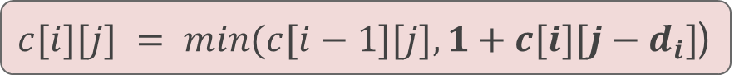
Make Change Problem1 – Dynamic Programming Solution
We can also find the coins to be included in the solution set as follows:
Start looking at c[3, 8] = c[2, 8] ⟹ So, not to include a coin with denomination 6.
Next go to c[2,8] ≠ c[1, 8] but c[2,8] = 1 + c[2,4]
So, include a coin with denomination 4
Now, got to c[2,4] ≠ c[1,4] but c[2,4] = 1+ c[2,0]
So, again include a coin with denomination 4
Go to c[2,0] = c[1,0] and stop.
$c[i][j] = min(c[i−1][j],1+c[i][j−d_{i}]$)
 | 0 | 1 | 2 | 3 | 4 | 5 | 6 | 7 | 8
$$d_{1}=1$$ | 0 | 1 | 2 | 3 | 4 | 5 | 6 | 7 | 8
$$d_{2}=4$$ | 0 | 1 | 2 | 3 | 1 | 2 | 3 | 4 | 2
$$d_{3}=6$$ | 0 | 1 | 2 | 3 | 1 | 2 | 1 | 2 | 2
Solution contains 2 coins with denomination 4

Slide 30
Make Change Problem2 – Dynamic Programming Solution
Given a value N, if we want to make change for N Rs, and we have infinite supply of each of S = { S₁, S₂, .. , S_{m}} valued coins
N = 4 and S = {1,2,3}, there are four solutions: {1,1,1,1},{1,1,2},{2,2},{1,3}. So output should be 4.
For N = 10 and S = {2, 5, 3, 6}, there are five solutions: {2,2,2,2,2}, {2,2,3,3}, {2,2,6}, {2,3,5} and {5,5}. So the output should be 5.
1) Optimal Substructure: To count the total number of solutions, we can divide all set solutions into two sets.
1) Solutions that do not contain m^{th} coin (or S_{m}).
2) Solutions that contain at least one S_{m}.
Let count(S[ ], m, n) be the function to count the number of solutions, then it can be written as sum of count(S[ ], m-1, n) and count(S[ ], m, n-S_{m}).
Therefore, the problem has optimal substructure property as the problem can be solved using solutions to subproblems.
2) Overlapping Subproblems
Following is a simple recursive implementation of the Coin Change problem. The implementation simply follows the recursive structure mentioned above.

Slide 31
({1,2,3},3,6)
Example: S={1,2,3} N=6
({array},size, N)
({1,2,3},3,3)
({1,2},2,6)
({1,2,3},3,0)
({1,2},2,3)
({1,2},2,4)
({1},1,6)
({1},1,5)
({1,2},2,1)
({1},1,3)
({1,2},2,2)
({1},1,4)
({ },0,6)
({1},1,4)
({ },0,5)
({1},1,3)
({1},1,0)

Slide 32
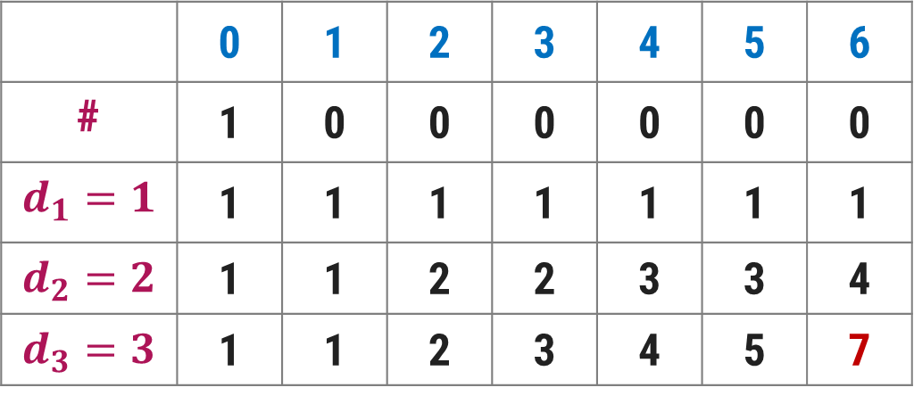
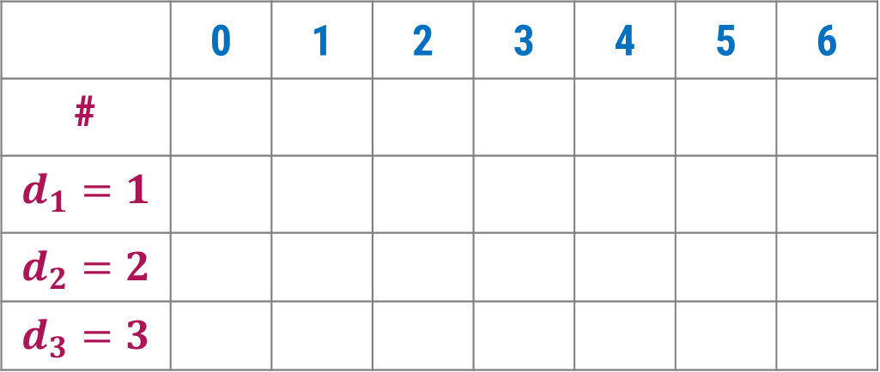
 | 0 | 1 | 2 | 3 | 4 | 5 | 6
#
$$d_{1}=1$$
$$d_{2}=2$$
$$d_{3}=3$$
Example: S={1,2,3} N=6
For every cell, we have two options:
Take that coin dp[i][j-s[i-1]]
Do not take that coin dp[i-1][j]
 | 0 | 1 | 2 | 3 | 4 | 5 | 6
# | 1 | 0 | 0 | 0 | 0 | 0 | 0
$$d_{1}=1$$ | 1 | 1 | 1 | 1 | 1 | 1 | 1
$$d_{2}=2$$ | 1 | 1 | 2 | 2 | 3 | 3 | 4
$$d_{3}=3$$ | 1 | 1 | 2 | 3 | 4 | 5 | 7

Slide 33
Time Complexity
int coinchange(vector<int>& a, int v, int n, vector<vector<int> >& dp)
{
if (v == 0)
return dp[n][v] = 1;
if (n == 0)
return 0;
if (dp[n][v] != -1)
return dp[n][v];
if (a[n - 1] <= v)
{
// Either Pick this coin or not
return dp[n][v] = coinchange(a, v - a[n - 1], n, dp) + coinchange(a, v, n - 1, dp);
}
else // We have no option but to leave this coin
return dp[n][v] = coinchange(a, v, n - 1, dp);
}
Time Complexity: O(M*N) Space Complexity: O(M*N)

Slide 34
0/1 Knapsack Problem

Slide 35
0/1 Knapsack
Given weights and values of n items, put these items in a knapsack of capacity W to get the maximum total value in the knapsack.
Method 1: Recursion by Brute-Force algorithm OR Exhaustive Search.
Approach: A simple solution is to consider all subsets of items and calculate the total weight and value of all subsets. Consider the only subsets whose total weight is smaller than W. From all such subsets, pick the maximum value subset.
Optimal Sub-structure: To consider all subsets of items, there can be two cases for every item.
Case 1: The item is included in the optimal subset.
Case 2: The item is not included in the optimal set.
Therefore, the maximum value that can be obtained from ‘n’ items is the max of the following two values.
Maximum value obtained by n-1 items and W weight (excluding nth item).
Value of n^{th} item plus maximum value obtained by n-1 items and W minus the weight of the nth item (including nth item).
If the weight of ‘n^{th}’ item is greater than ‘W’, then the nth item cannot be included and Case 1 is the only possibility.

Slide 36
In the following recursion tree, K() refers to knapSack().
The two parameters indicated in the following recursion tree are n and W.
The recursion tree is for following sample inputs.
wt[ ] = {1, 1, 1}, val[ ] = {10, 20, 30}, W = 2
K(n,W)
K(3, 2)
K(2, 2)
K(2, 1)
K(1, 2)
K(1, 1)
K(1, 1)
K(1, 0)
K(0, 2)
K(0, 1)
K(0, 1)
K(0, 0)
K(0, 1)
K(0, 0)

Slide 37
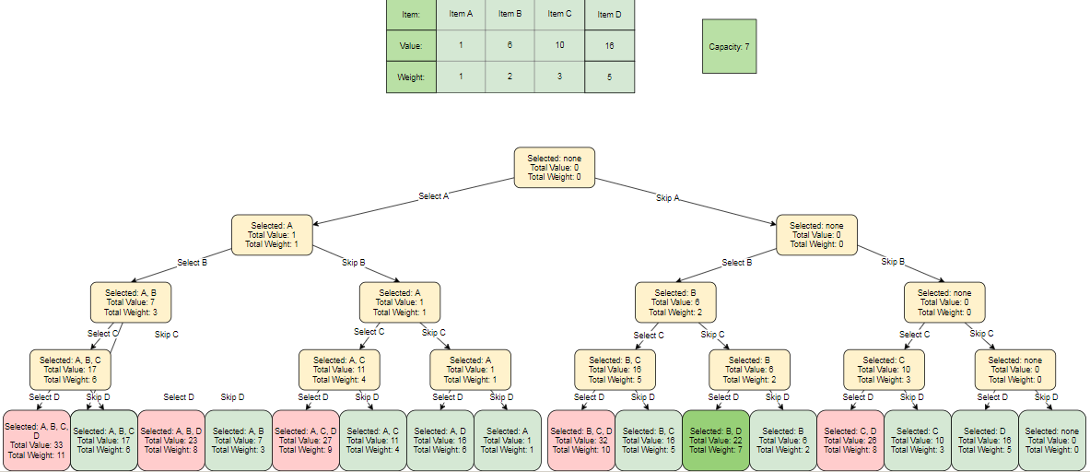
Recursion tree
Time complexity: O(2​^{n}​​), due to the number of calls with overlapping sub-calls
Auxiliary space: O(1), no additional storage is needed.

Slide 38
Method 2: Like other typical Dynamic Programming(DP) problems, re-computation of same subproblems can be avoided by constructing a temporary array V[][] in bottom-up manner. Following is Dynamic Programming based implementation.
Complexity Analysis:
Time Complexity: O(N*W). where ‘N’ is the number of weight element and ‘W’ is capacity. As for every weight element we traverse through all weight capacities 1<=w<=W.
Space Complexity: O(N*W). The use of 2-D array of size ‘N*W’.

Slide 39
Method 3: This method uses Memoization Technique (an extension of recursive approach). This method is basically an extension to the recursive approach so that we can overcome the problem of calculating redundant cases and thus increased complexity.
We can solve this problem by simply creating a 2-D array that can store a particular state (n, w) if we get it the first time. Now if we come across the same state (n, w) again instead of calculating it in exponential complexity we can directly return its result stored in the table in constant time.
This method gives an edge over the recursive approach in this aspect.
Complexity Analysis:
Time Complexity: O(n*w). where ‘N’ is the number of weight element and ‘W’ is capacity. As for every weight element we traverse through all weight capacities 1<=w_{i}<=w.
Space Complexity: O(n*w). The use of 2-D array of size ‘n*w’.

Slide 40
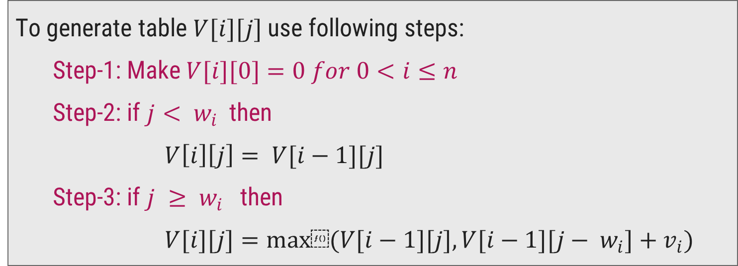
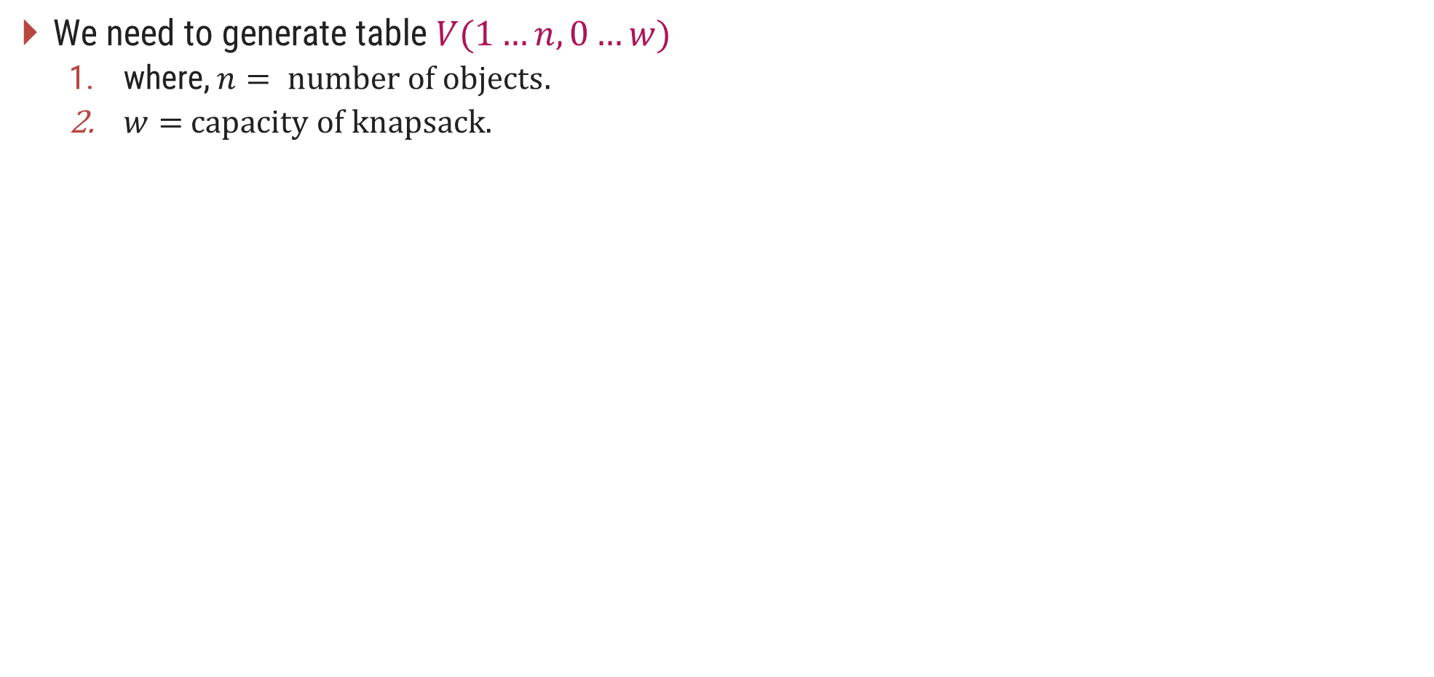
0/1 Knapsack Problem - Dynamic Programming Solution
We need to generate table $V(1…n,0…w)$
where, $n= \text{number} \text{of} \text{objects}.$
$w=$ $\text{capacity} \text{of} \text{knapsack}\text{. }$
To generate table $V[i][j]$use following steps:
Step-1: Make $V[i][0]=0 for 0<i≤n$
Step-2: if $j< w_{i}$then
$V\left[i\right]\left[j\right]= V[i−1][j]$
Step-3: if $j ≥ w_{i}$then
$V[i][j]=max⁡(V[i−1][j], V[i−1][j− w_{i}]+v_{i})$

Slide 41
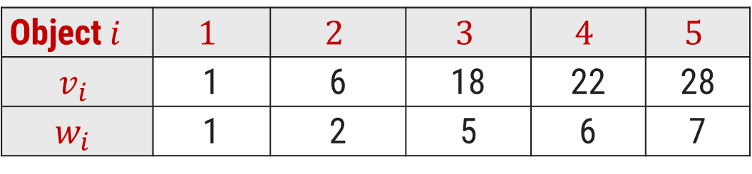
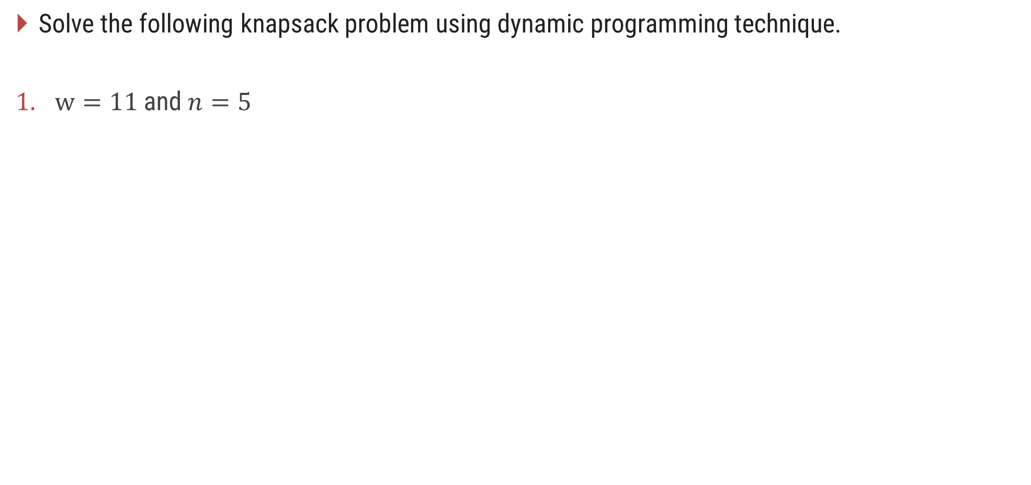
0/1 Knapsack Problem - Dynamic Programming Solution
Solve the following knapsack problem using dynamic programming technique.
$w=11$and $n=5$
Object$i$ | $$1$$ | $$2$$ | $$3$$ | $$4$$ | $$5$$
$$v_{i}$$ | 1 | 6 | 18 | 22 | 28
$$w_{i}$$ | 1 | 2 | 5 | 6 | 7

Slide 42

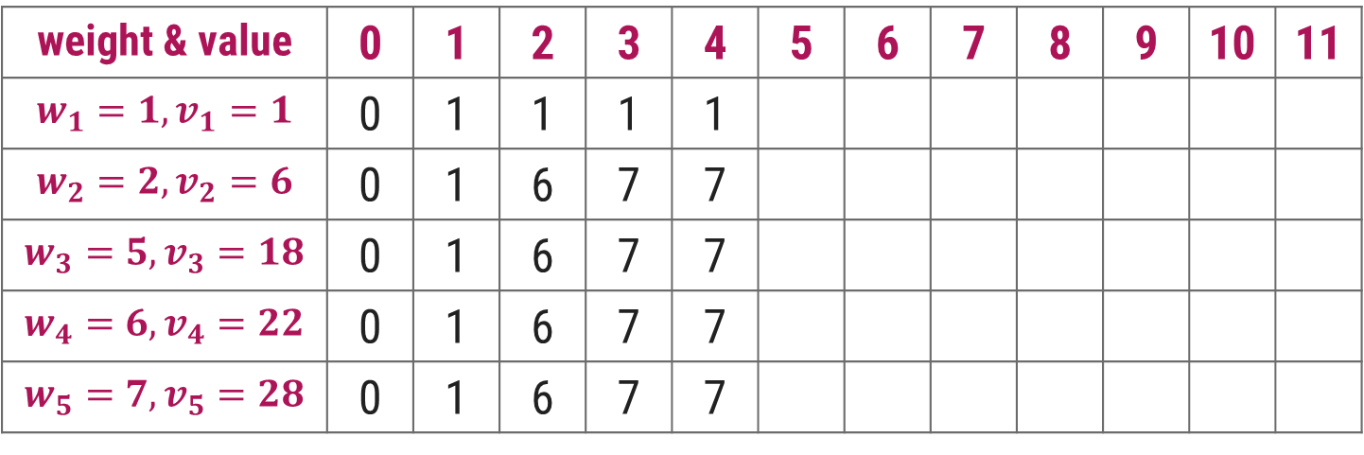
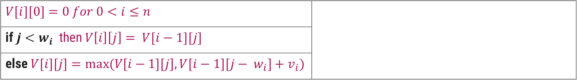
0/1 Knapsack Problem - Dynamic Programming Solution
$$V[i][0]=0 for 0<i≤n$$
if $j<w_{i}$then $V\left[i\right]\left[j\right]= V[i−1][j]$
else $V[i][j]=max⁡(V[i−1][j], V[i−1][j− w_{i}]+v_{i})$
$$j$$
Knapsack Capacity
weight & value | 0 | 1 | 2 | 3 | 4 | 5 | 6 | 7 | 8 | 9 | 10 | 11
$$w_{1}=1, v_{1}=1$$ | 0 | 1 | 1 | 1 | 1
$$w_{2}=2, v_{2}=6$$ | 0 | 1 | 6 | 7 | 7
$$w_{3}=5, v_{3}=18$$ | 0 | 1 | 6 | 7 | 7
$$w_{4}=6, v_{4}=22$$ | 0 | 1 | 6 | 7 | 7
$$w_{5}=7, v_{5}=28$$ | 0 | 1 | 6 | 7 | 7

Slide 43
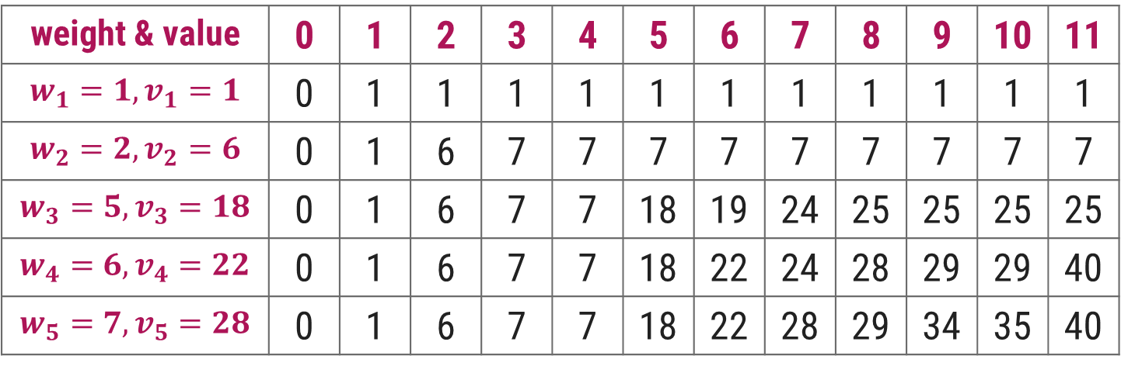
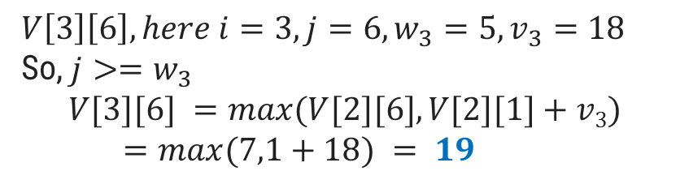
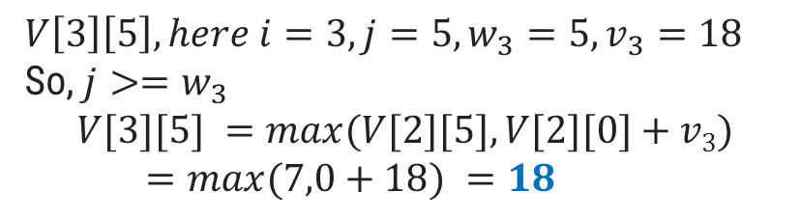
0/1 Knapsack Problem - Dynamic Programming Solution
$$V[i][0]=0 for 0<i≤n$$
if $j<w_{i}$then $V\left[i\right]\left[j\right]= V[i−1][j]$
else $V[i][j]=max⁡(V[i−1][j], V[i−1][j− w_{i}]+v_{i})$
$$V\left[3\right]\left[6\right], here i=3,j=6, w_{3}=5, v_{3}=18$$
So, $j>=w_{3}$
$$V[3][6] =max⁡(V[2][6],V[2][1]+v3)$$
$=max⁡(7,1+18) = 19$
$$V\left[3\right]\left[5\right], here i=3,j=5, w_{3}=5, v_{3}=18$$
So, $j>=w_{3}$
$$V[3][5] =max⁡(V[2][5],V[2][0]+v3)$$
$=max⁡(7,0+18) =18$
$$j$$
Knapsack Capacity
weight & value | 0 | 1 | 2 | 3 | 4 | 5 | 6 | 7 | 8 | 9 | 10 | 11
$$w_{1}=1, v_{1}=1$$ | 0 | 1 | 1 | 1 | 1 | 1 | 1 | 1 | 1 | 1 | 1 | 1
$$w_{2}=2, v_{2}=6$$ | 0 | 1 | 6 | 7 | 7 | 7 | 7 | 7 | 7 | 7 | 7 | 7
$$w_{3}=5, v_{3}=18$$ | 0 | 1 | 6 | 7 | 7 | 18 | 19 | 24 | 25 | 25 | 25 | 25
$$w_{4}=6, v_{4}=22$$ | 0 | 1 | 6 | 7 | 7 | 18 | 22 | 24 | 28 | 29 | 29 | 40
$$w_{5}=7, v_{5}=28$$ | 0 | 1 | 6 | 7 | 7 | 18 | 22 | 28 | 29 | 34 | 35 | 40

Slide 44
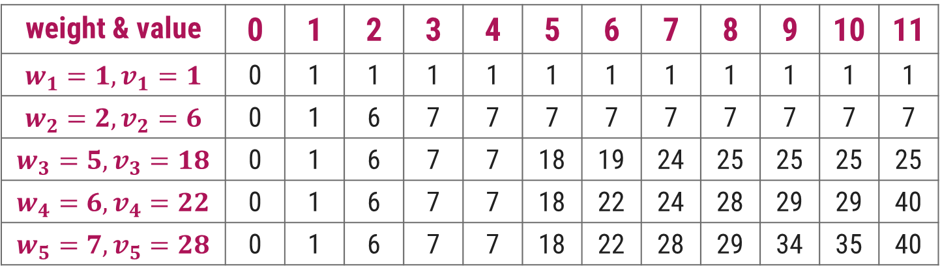
0/1 Knapsack Problem - Dynamic Programming Solution
We can also find the objects to be carried in the knapsack as follows,
Start looking at V[5, 11] = V[4, 11] ⟹ So not to include object 5
Next go to V[4, 11] ≠ V[3, 11] but V[4, 11] = V[3,11-w₄]+v₄ = V[3, 5]+22 So include object 4
Now go to V[3,5] ≠ V[2,5] but V[3,5] = V[2,5-w₃]+v₃ = V[2,0]+18 So include object 3
Now V[2,0] = V[1, 0] and V[1,0] = V[0,0] ⟹ So objects 2 and 1 are not included.
$$V[i][j]=max⁡(V[i−1][j], V[i−1][j− wi]+v_{i})$$
weight & value | 0 | 1 | 2 | 3 | 4 | 5 | 6 | 7 | 8 | 9 | 10 | 11
$$w_{1}=1, v_{1}=1$$ | 0 | 1 | 1 | 1 | 1 | 1 | 1 | 1 | 1 | 1 | 1 | 1
$$w_{2}=2, v_{2}=6$$ | 0 | 1 | 6 | 7 | 7 | 7 | 7 | 7 | 7 | 7 | 7 | 7
$$w_{3}=5, v_{3}=18$$ | 0 | 1 | 6 | 7 | 7 | 18 | 19 | 24 | 25 | 25 | 25 | 25
$$w_{4}=6, v_{4}=22$$ | 0 | 1 | 6 | 7 | 7 | 18 | 22 | 24 | 28 | 29 | 29 | 40
$$w_{5}=7, v_{5}=28$$ | 0 | 1 | 6 | 7 | 7 | 18 | 22 | 28 | 29 | 34 | 35 | 40

Slide 45
Algorithm-Iterative(bottom-up)= O(n*w)
int max(int a, int b)
{
return (a > b) ? a : b;
}
// Returns the maximum value that can be put in a knapsack of capacity W
int knapSack(int W, int wt[], int val[], int n)
{
int i, w;
int K[n + 1][W + 1];
// Build table K[][] in bottom up manner
for (i = 0; i <= n; i++)
{
for (w = 0; w <= W; w++)
{
if (i == 0 || w == 0)
K[i][w] = 0;
else if (wt[i - 1] <= w)
K[i][w] = max(val[i - 1] + K[i - 1][w - wt[i - 1]], K[i - 1][w]);
else
K[i][w] = K[i - 1][w];
}
}
return K[n][W];
}

Slide 46
Algorithm(top-down)=O(n*w).
// Returns the value of maximum profit
int knapSackRec(int W, int wt[],int val[], int i, int** dp)
{
// base condition
if (i < 0)
return 0;
if (dp[i][W] != -1)
return dp[i][W];
if (wt[i] > W) {
// Store the value of function call stack in table before return
dp[i][W] = knapSackRec(W, wt, val, i - 1, dp);
return dp[i][W];
}
else {
// Store value in a table before return
dp[i][W] = max(val[i] + knapSackRec(W - wt[i], wt, val, i - 1, dp), knapSackRec(W, wt, val, i - 1, dp));
// Return value of table after storing
return dp[i][W];
}
}

Slide 47
Longest Common Subsequence

Slide 48
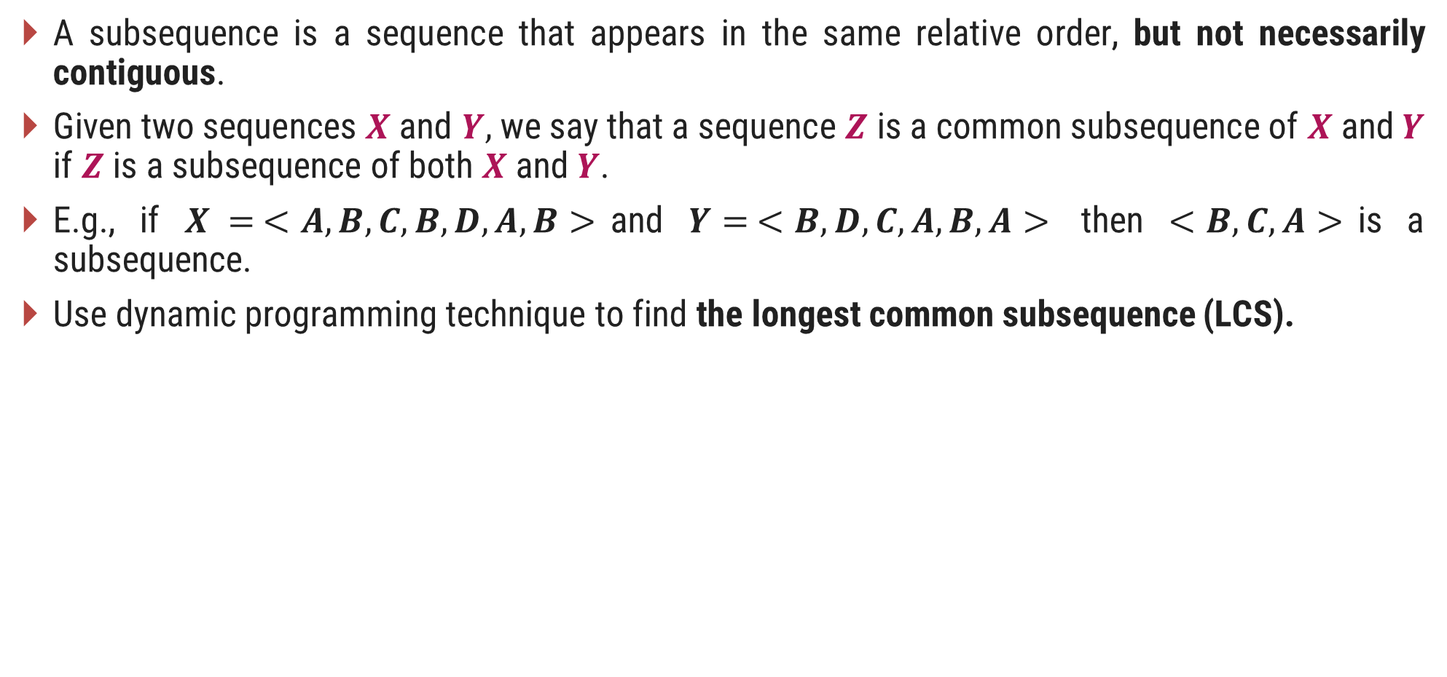
Introduction
A subsequence is a sequence that appears in the same relative order, but not necessarily contiguous.
Given two sequences $X$ and $Y,$ we say that a sequence $Z$ is a common subsequence of $X$ and $Y$ if $Z$ is a subsequence of both $X$ and $Y$.
E.g., if $X = <A, B, C, B, D, A, B>$and $Y= <B, D, C, A, B, A>$ then $<B, C, A>$is a subsequence.
Use dynamic programming technique to find the longest common subsequence (LCS).

Slide 49
Problem statement
Given two sequences, find the length of longest subsequence present in both of them.
A subsequence is a sequence that appears in the same relative order, but not necessarily contiguous. For example, “abc”, “abg”, “bdf”, “aeg”, ‘”acefg”, .. etc are sub-sequences of “abcdefg”.
In order to find out the complexity of brute force approach, we need to first know the number of possible different sub-sequences of a string with length n i.e., find the number of sub-sequences with lengths ranging from 1,2,..n-1.
Number of combinations with 1 element are ^{n}C_{1.} Number of combinations with 2 elements are ^{n}C₂ and so forth and so on.
We know that ^{n}C₀ + ^{n}C₁ + ^{n}C₂ + … ^{n}C_{n} = 2^{n}.
So a string of length n has 2^{n}-1 different possible sub-sequences since we do not consider the subsequence with length 0.
This implies that the time complexity of the brute force approach will be O(n * 2^{n}). Note that it takes O(n) time to check if a sub-sequence is common to both the strings. This time complexity can be improved using dynamic programming.

Slide 50
Optimal sub-structure
Consider the two string X and Y:
X: ABCBDAB
Y: BDCABA
The length of the LCS is 4, LCS are BDAB, BCAB, and BCBA
A naive solution is to check if every subsequence of X [1..m] to see if it is also a subsequence of Y [1...n] . As there are 2^{m} subsequences possible of x .
The time complexity of this solution would be O(n. 2m), where m is the length of the first string and n is the length of the second string.
The LCS problem has optimal substructure. That means the problem can be broken down into smaller, simple "subproblems", which can be broken down into yet simpler subproblems, and so on, until, finally, the solution becomes trivial.
Let's consider two sequences, X and Y , of length m and n that both end-up with same element.
To find their LCS, shorten each sequence by removing the last element, find the LCS of the shortened sequences, and that LCS append the removed element. So, we can say that.
LCS( X[1…m], Y[1…n] ) = LCS ( X[1...n-1] ), Y[1...n-1] ) + X[m] , if X[m]=Y[n]

Slide 51
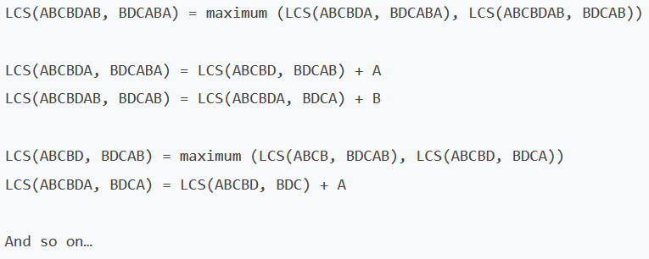
2. Now suppose that the two sequences does not end in the same symbol.
Then the LCS of X and Y is the maximum of the two sequences LCS (X [1..m-1], Y[1...n]) and LCS (x [1...m] , Y [1...n-l] ) .
To understand this property, let's consider the two following sequences:
X: ABCBDAB (n elements)
Y: BDCABA (m elements)
The LCS of these two sequences either ends with B (the last element of the sequence x ) or does not.
Case 1: If LCS ends with B , then it cannot end with A , and we can remove A from the sequence Y , and the problem reduces to LCS (X [1..m], Y [1...n-1] )
Case 2: If LCS does not end with B , then we can remove B from sequence x and the problem reduces to LCS (X [1..n-1], Y [1...n]) . For example,

Slide 52
Recursive solution
// Function to find the length of the longest common subsequence of sequences `X[0…m-1]` and `Y[0…n-1]`
int LCSLength(string X, string Y, int m, int n)
{
// return if the end of either sequence is reached
if (m == 0 || n == 0) {
return 0;
}
// if the last character of `X` and `Y` matches
if (X[m - 1] == Y[n - 1]) {
return LCSLength(X, Y, m - 1, n - 1) + 1;
}
// otherwise, if the last character of `X` and `Y` don't match
return max(LCSLength(X, Y, m, n - 1), LCSLength(X, Y, m - 1, n));
}

Slide 53
The worst-case time complexity of the above solution is O(2^{m+n}) and occupies space in the call stack, where m and n are the length of the strings X and Y .
The worst case happens when there is no common subsequence present in X and Y (i.e., LCS is 0), and each recursive call will end up in two recursive calls.

Slide 54
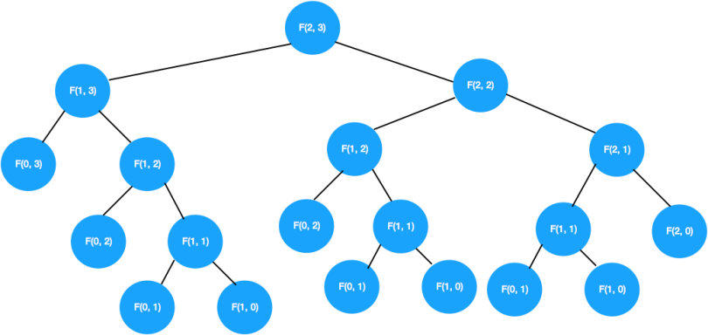
Overlapping Subproblems:

Slide 55
Recursive solution(top-down)
// Function to find the length of the longest common subsequence of substring `X[0…m-1]` and `Y[0…n-1]`
int LCSLength(string X, string Y, int m, int n, auto &lookup)
{
// return if the end of either string is reached
if (m == 0 || n == 0) {
return 0;
}
// construct a unique map key from dynamic elements of the input
string key = to_string(m) + "|" + to_string(n);
// if the subproblem is seen for the first time, solve it and store its result in a map
if (lookup.find(key) == lookup.end())
{
// if the last character of `X` and `Y` matches
if (X[m - 1] == Y[n - 1]) {
lookup[key] = LCSLength(X, Y, m - 1, n - 1, lookup) + 1;
}
else {
// otherwise, if the last character of `X` and `Y` don't match
lookup[key] = max(LCSLength(X, Y, m, n - 1, lookup), LCSLength(X, Y, m - 1, n, lookup));
}
}
// return the subproblem solution from the map
return lookup[key];
}

Slide 56
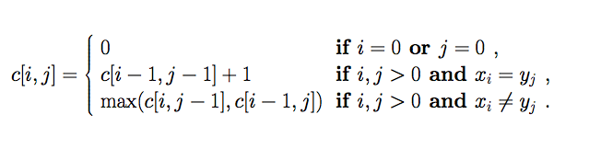
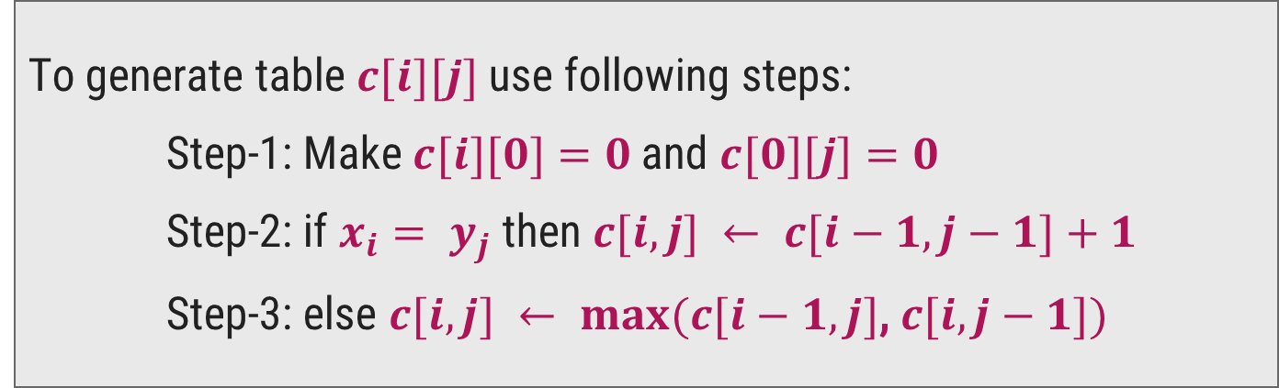
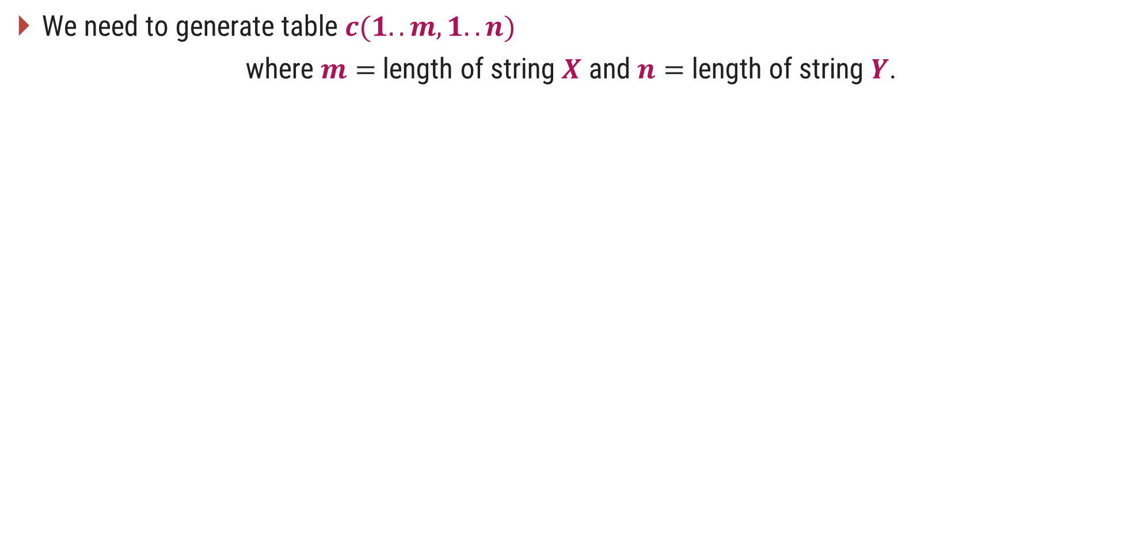
Recursive solution(bottom-up)
We need to generate table $c(1..m, 1..n)$
where $m=$length of string $X$ and $n=$ length of string $Y$.
To generate table $c[i][j]$use following steps:
Step-1: Make $c[i][0]=0$and $c[0][j]=0$
Step-2: if $x_{i}= y_{j}$then $c[i,j] ← c[i−1,j−1]+1$
Step-3: else $c[i,j] ← max(c[i−1,j]$, $c[i,j−1])$

Slide 57
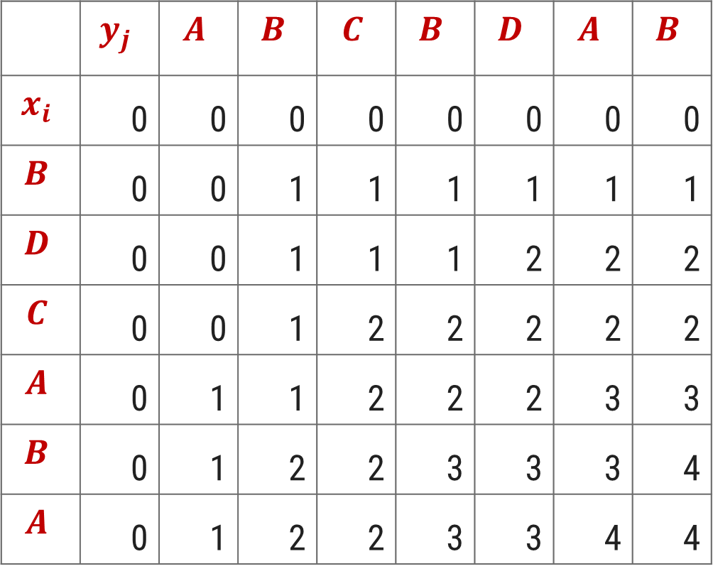
LCS – Dynamic Programming Solution
$if x_{i}= y_{j} \text{then} c[i,j] ← c[i−1,j−1]+1$ else $c[i,j] ←$max($c[i−1,j]$, $c[i,j−1])$
 | $$y_{j}$$ | $$A$$ | $$B$$ | $$C$$ | $$B$$ | $$D$$ | $$A$$ | $$B$$
$$x_{i}$$ | 0 | 0 | 0 | 0 | 0 | 0 | 0 | 0
$$B$$ | 0 | 0 | 1 | 1 | 1 | 1 | 1 | 1
$$D$$ | 0 | 0 | 1 | 1 | 1 | 2 | 2 | 2
$$C$$ | 0 | 0 | 1 | 2 | 2 | 2 | 2 | 2
$$A$$ | 0 | 1 | 1 | 2 | 2 | 2 | 3 | 3
$$B$$ | 0 | 1 | 2 | 2 | 3 | 3 | 3 | 4
$$A$$ | 0 | 1 | 2 | 2 | 3 | 3 | 4 | 4

Slide 58
LCS – Dynamic Programming Solution
$if x_{i}= y_{j} \text{then} c[i,j] ← c[i−1,j−1]+1$ else $c[i,j] ←$max($c[i−1,j]$, $c[i,j−1])$
 | $$y_{j}$$ | $$A$$ | $$B$$ | $$C$$ | $$B$$ | $$D$$ | $$A$$ | $$B$$
$$x_{i}$$ | 0 | 0 | 0 | 0 | 0 | 0 | 0 | 0
$$B$$ | 0 | 0 | 1 | 1 | 1 | 1 | 1 | 1
$$D$$ | 0 | 0 | 1 | 1 | 1 | 2 | 2 | 2
$$C$$ | 0 | 0 | 1 | 2 | 2 | 2 | 2 | 2
$$A$$ | 0 | 1 | 1 | 2 | 2 | 2 | 3 | 3
$$B$$ | 0 | 1 | 2 | 2 | 3 | 3 | 3 | 4
$$A$$ | 0 | 1 | 2 | 2 | 3 | 3 | 4 | 4

Slide 59
LCS – Dynamic Programming Solution
$if x_{i}= y_{j} \text{then} c[i,j] ← c[i−1,j−1]+1$ else $c[i,j] ←$max($c[i−1,j]$, $c[i,j−1])$
 | $$y_{j}$$ | $$A$$ | $$B$$ | $$C$$ | $$B$$ | $$D$$ | $$A$$ | $$B$$
$$x_{i}$$ | 0 | 0 | 0 | 0 | 0 | 0 | 0 | 0
$$B$$ | 0 | 0 | 1 | 1 | 1 | 1 | 1 | 1
$$D$$ | 0 | 0 | 1 | 1 | 1 | 2 | 2 | 2
$$C$$ | 0 | 0 | 1 | 2 | 2 | 2 | 2 | 2
$$A$$ | 0 | 1 | 1 | 2 | 2 | 2 | 3 | 3
$$B$$ | 0 | 1 | 2 | 2 | 3 | 3 | 3 | 4
$$A$$ | 0 | 1 | 2 | 2 | 3 | 3 | 4 | 4

Slide 60
LCS – Dynamic Programming Solution
$X= < A, B, C, B, D, A, B>$and $Y= <B, D, C, A, B, A>$ and LCS = $<B, D, A, B>$
 | $$y_{j}$$ | $$A$$ | $$B$$ | $$C$$ | $$B$$ | $$D$$ | $$A$$ | $$B$$
$$x_{i}$$ | 0 | 0 | 0 | 0 | 0 | 0 | 0 | 0
$$B$$ | 0 | 0 | 1 | 1 | 1 | 1 | 1 | 1
$$D$$ | 0 | 0 | 1 | 1 | 1 | 2 | 2 | 2
$$C$$ | 0 | 0 | 1 | 2 | 2 | 2 | 2 | 2
$$A$$ | 0 | 1 | 1 | 2 | 2 | 2 | 3 | 3
$$B$$ | 0 | 1 | 2 | 2 | 3 | 3 | 3 | 4
$$A$$ | 0 | 1 | 2 | 2 | 3 | 3 | 4 | 4

Slide 61
Time and space complexity:
Time complexity: O(m.n)
Space complexity: O(m.n)

Slide 62
Chain Matrix Multiplication

Slide 63

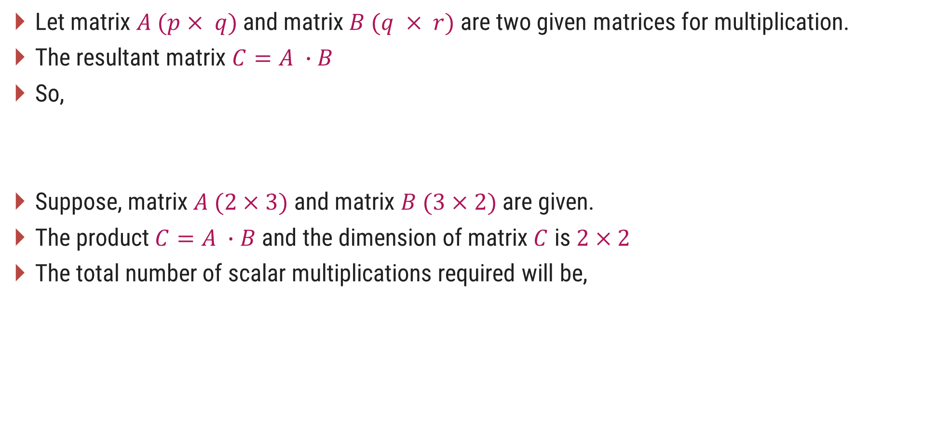
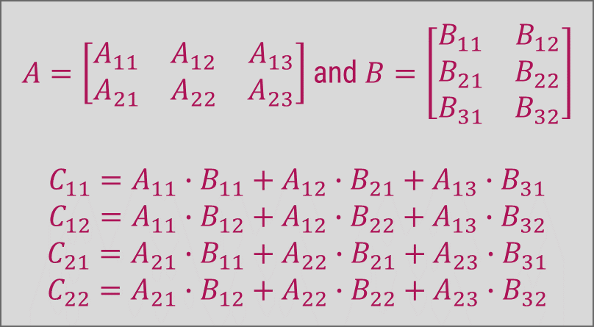

Introduction
$A=\left[\begin{matrix}A_{11} & A_{12} & A_{13} \\ A_{21} & A_{22} & A_{23}\end{matrix}\right]$ and $B=\left[\begin{matrix}B_{11} & B_{12} \\ B_{21} & B_{22} \\ B_{31} & B_{32}\end{matrix}\right]$
$$C_{11}=A_{11}∙B_{11}+A_{12}∙B_{21}+A_{13}∙B_{31}$$
$$C_{12}=A_{11}∙B_{12}+A_{12}∙B_{22}+A_{13}∙B_{32}$$
$$C_{21}=A_{21}∙B_{11}+A_{22}∙B_{21}+A_{23}∙B_{31}$$
$$C_{22}=A_{21}∙B_{12}+A_{22}∙B_{22}+A_{23}∙B_{32}$$
Let matrix $A (p× q)$and matrix $B (q × r)$are two given matrices for multiplication.
The resultant matrix $C=A ∙B$
So,
Suppose, matrix $A (2×3)$and matrix $B (3×2)$are given.
The product $C=A ∙B$and the dimension of matrix $C$ is $2×2$
The total number of scalar multiplications required will be,
$C_{ij}=\sum_{k=1}^{q}{a_{ik}b_{kj}}$ Where, $1≤i≤p$and $1≤j≤r$
$$p∗q∗r=2∗3∗2=12$$

Slide 64
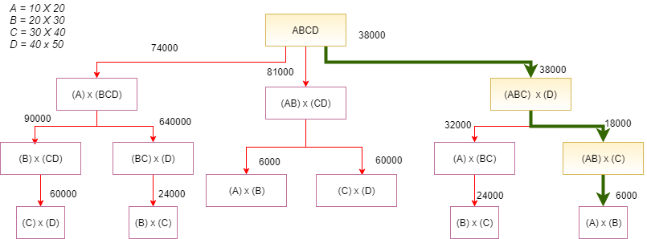
The total number of parenthesization possible: C(2n,n)/(n+1)

Slide 65
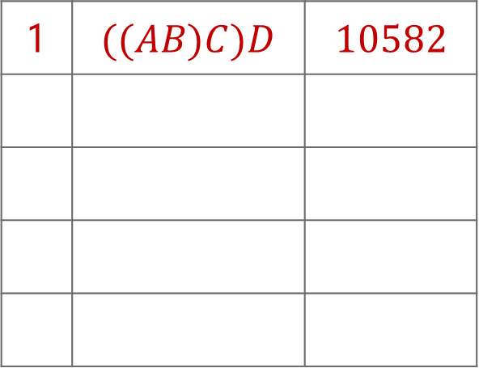
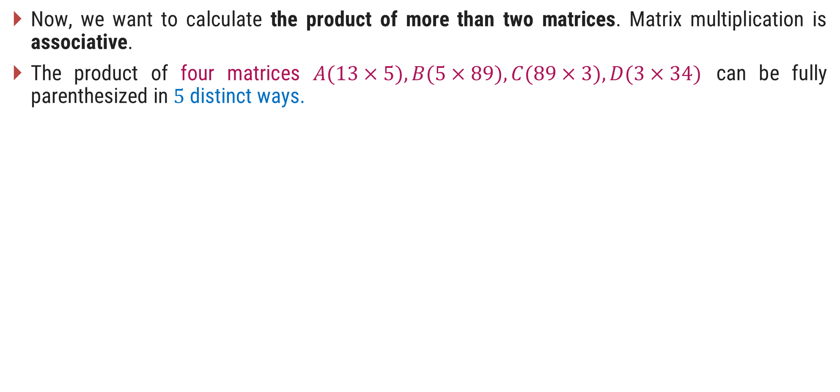

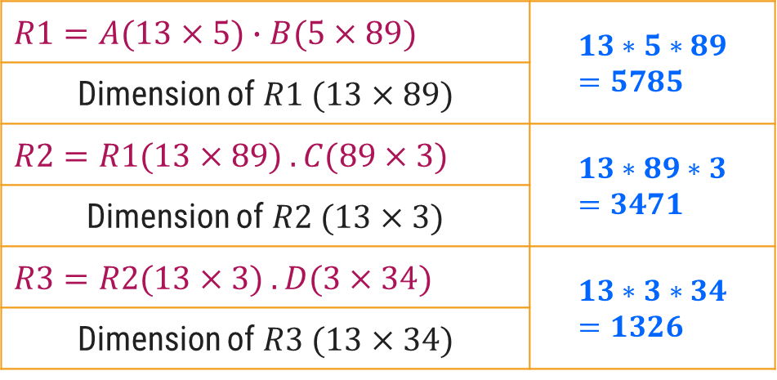
Matrix Chain Multiplication
Now, we want to calculate the product of more than two matrices. Matrix multiplication is associative.
The product of four matrices $A(13×5), B(5×89), C(89×3), D(3×34)$ can be fully parenthesized in $5$ distinct ways.
1 | $$((AB)C)D$$ | $$10582$$
$$R1=A(13×5)∙B(5×89)$$ | $$13∗5∗89=5785$$
Dimension of $R1 (13×89)$
$$R2=R1(13×89) . C(89×3)$$ | $$13∗89∗3=3471$$
Dimension of $R2 (13×3)$
$$R3=R2(13×3) . D(3×34)$$ | $$13∗3∗34=1326$$
Dimension of $R3 (13×34)$
$$10582$$

Slide 66
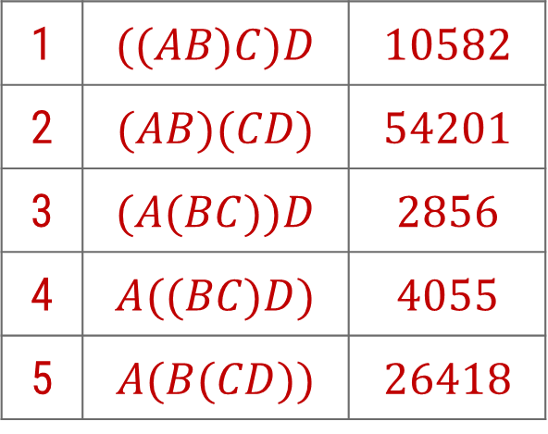

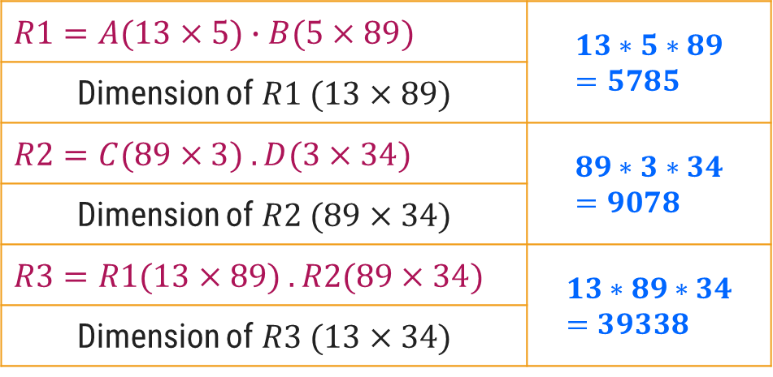
Matrix Chain Multiplication
Now, we want to calculate the product of more than two matrices. Matrix multiplication is associative.
The product of four matrices $A(13×5), B(5×89), C(89×3), D(3×34)$ can be fully parenthesized in $5$ distinct ways.
1 | $$((AB)C)D$$ | $$10582$$
2 | $$(AB)(CD)$$ | $$54201$$
3 | $$(A(BC))D$$ | $$2856$$
4 | $$A((BC)D)$$ | $$4055$$
5 | $$A(B(CD))$$ | $$26418$$
$$R1=A(13×5)∙B(5×89)$$ | $$13∗5∗89=5785$$
Dimension of $R1 (13×89)$
$$R2=C(89×3) . D(3×34)$$ | $$89∗3∗34=9078$$
Dimension of $R2 (89×34)$
$$R3=R1(13×89) . R2(89×34)$$ | $$13∗89∗34=39338$$
Dimension of $R3 (13×34)$
$$54201$$

Slide 67
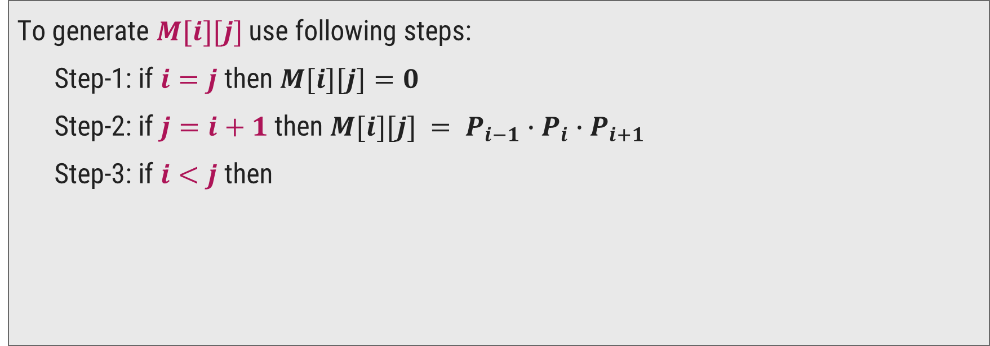

Matrix Chain Multiplication using Dynamic Programming
Matrix table $M[i][j]$stores the cost of multiplications.
To generate $M[i][j]$use following steps:
Step-1: if $i=j$then $M[i][j]=0$
Step-2: if $j=i+1$then $M[i][j] = P_{i−1}∙P_{i}∙P_{i+1}$
Step-3: if $i<j$then
$$M[i][j]= min⁡(M[i][k]+M[k+1][j]+P_{i−1}∙P_{k}∙P_{j}) with i≤k<j$$

Slide 68


Matrix Chain Multiplication using Dynamic Programming
Here dimensions are, $P_{0}=5,P_{1}=4,P_{2}=6,P_{3}=2,P_{4}=7.$
There would be $4$matrices $A(5×4$),$B(4×6), C(6×2)$and $D(2×7).$
Step-2: if $j=i+1$then $M[i][j] = P_{i−1}∙P_{i}∙P_{i+1}$
Step-1: if $i=j$then $M[i][j]=0$
So, $M[1][1] = M[2][2] = M[3][3] = M[4][4] = 0$
$$M[1][2] = P_{0} ∗P_{1}∗P_{2}= 5 ∗ 4 ∗ 6 = 120$$
$$M[2][3] = P_{1} ∗P_{2}∗P_{3}=4 ∗6 ∗2 =48$$
$$M[3][4] = P_{2} ∗P_{3}∗P_{4}=6 ∗2 ∗7 =84$$
 | 1 | 2 | 3 | 4
1 | 0 | 120
2 | -- | 0 | 48
3 | -- | -- | 0 | 84
4 | -- | -- | -- | 0

Slide 69



Matrix Chain Multiplication using Dynamic Programming
Here dimensions are,
$P_{0}=5,P_{1}=4,P_{2}=6,P_{3}=2,P_{4}=7.$
$$M\left[1\right]\left[3\right], here i<j$$
$$for i=1,j=3 and k=1 or 2$$
$$because i≤k≤ j−1$$
$$For k=1$$
$$M[1][3]=M[1][1]+M[2][3]+P0∗P1∗P3$$
$$=0+48+5∗4∗2$$
$$M[1][3]=88$$
$$For k=2$$
$$M[1][3]=M[1][2]+M[3][3]+P0∗P2∗P3$$
$$=120+0+5∗6∗2$$
$$M[1][3]=180$$
step 3:
$$M\left[i\right]\left[j\right]=min\left(M\left[i\right]\left[k\right]+M\left[k+1\right]\left[j\right]+P_{i−1}∙P_{k}∙P_{j}\right)$$
$$with i≤k<j$$
 | 1 | 2 | 3 | 4
1 | 0 | 120 | 88
2 | -- | 0 | 48
3 | -- | -- | 0 | 84
4 | -- | -- | -- | 0

Slide 70

Matrix Chain Multiplication using Dynamic Programming
Here dimensions are,
$P_{0}=5,P_{1}=4,P_{2}=6,P_{3}=2,P_{4}=7.$
$$M\left[2\right]\left[4\right], here i<j$$
$$for i=2,j=4 and k=2 or 3$$
$$because i≤k≤ j−1$$
$$For k=2$$
$$M[2][4]=M[2][2]+M[3][4]+P1∗P2∗P4$$
$$=0+84+4∗6∗7$$
$$M[1][3]=252$$
$$For k=3$$
$$M[2][4]=M[2][3]+M[4][4]+P1∗P3∗P4$$
$$=48+0+4∗2∗7$$
$$M[2][4]=104$$
step 3:
$$M\left[i\right]\left[j\right]=min\left(M\left[i\right]\left[k\right]+M\left[k+1\right]\left[j\right]+P_{i−1}∙P_{k}∙P_{j}\right)$$
$$with i≤k<j$$
 | 1 | 2 | 3 | 4
1 | 0 | 120 | 88
2 | -- | 0 | 48 | 104
3 | -- | -- | 0 | 84
4 | -- | -- | -- | 0

Slide 71

Matrix Chain Multiplication using Dynamic Programming
Here dimensions are,
$P_{0}=5,P_{1}=4,P_{2}=6,P_{3}=2,P_{4}=7.$
$$M\left[1\right]\left[4\right], here i < j$$
$$for i=1,j=4 and k=1 or 2 or 3$$
$$because i ≤ k ≤ j−1$$
$$For k=1$$
$$M[1][4]=M[1][1]+M[2][4]+P0∗P1∗P4$$
$$= 0+104+5∗4∗7 = 244$$
$$For k=2$$
$$M[1][4]=M[1][2]+M[3][4]+P0∗P2∗P4$$
$$= 120+84+5∗6∗7 = 414$$
$$For k=3$$
$$M[1][4]=M[1][3]+M[4][4]+P0∗P3∗P4$$
$$= 88+0+5∗2∗7=158$$
step 3:
$$M\left[i\right]\left[j\right]=min\left(M\left[i\right]\left[k\right]+M\left[k+1\right]\left[j\right]+P_{i−1}∙P_{k}∙P_{j}\right)$$
$$with i≤k<j$$
 | 1 | 2 | 3 | 4
1 | 0 | 120 | 88 | 158
2 | -- | 0 | 48 | 104
3 | -- | -- | 0 | 84
4 | -- | -- | -- | 0

Slide 72
Matrix Chain Multiplication using Dynamic Programming
How to parenthesize matrices?
$$M\left[1\right]\left[4\right], here i < j$$
$$for i=1,j=4 and k=1 or 2 or 3$$
$$because i ≤ k ≤ j−1$$
$$For k=1$$
$$M[1][4]=M[1][1]+M[2][4]+P0∗P1∗P4$$
$$= 0+104+5∗4∗7 = 244$$
$$For k=2$$
$$M[1][4]=M[1][2]+M[3][4]+P0∗P2∗P4$$
$$= 120+84+5∗6∗7 = 414$$
$$For k=3$$
$$M[1][4]=M[1][3]+M[4][4]+P0∗P3∗P4$$
$$= 88+0+5∗2∗7=158$$
A B C D
 | 1 | 2 | 3 | 4
1 | 0 | 120 | 88 | 158
2 | -- | 0 | 48 | 104
3 | -- | -- | 0 | 84
4 | -- | -- | -- | 0

Slide 73
Matrix Chain Multiplication using Dynamic Programming
How to parenthesize matrices?
$$M\left[1\right]\left[3\right], here i<j$$
$$for i=1,j=3 and k=1 or 2$$
$$because i≤k≤ j−1$$
$$For k=1$$
$$M[1][3]=M[1][1]+M[2][3]+P0∗P1∗P3$$
$$=0+48+5∗4∗2$$
$$M[1][3]=88$$
$$For k=2$$
$$M[1][3]=M[1][2]+M[3][3]+P0∗P2∗P3$$
$$=120+0+5∗6∗2$$
$$M[1][3]=180$$
A B C D
 | 1 | 2 | 3 | 4
1 | 0 | 120 | 88 | 158
2 | -- | 0 | 48 | 104
3 | -- | -- | 0 | 84
4 | -- | -- | -- | 0

Slide 74

Matrix Chain Multiplication using Dynamic Programming
Here dimensions are, $P_{0}=5,P_{1}=4,P_{2}=6,P_{3}=2,P_{4}=7.$
There would be $4$matrices $A(5×4$),$B(4×6), C(6×2)$and $D(2×7).$
A B C D
$$R1=B.C$$ | $$4 ∗6∗2=48$$
$$R2=A.R1$$ | $$5 ∗4∗2=40$$
$$R3=R1.D$$ | $$5 ∗2∗7=70$$
158

Slide 75
All Pair Shortest Path – Floyd’s Algorithm

Slide 76

Introduction
Given a directed, connected weighted graph $G(V, E),$for each edge $⟨u, v⟩∈E$, a weight $w(u, v)$is associated with each edge.
The all pairs of shortest paths problem is to find a shortest path from $u$ to $v$ for every pair of vertices $u$ and $v$ in $V$.
Floyd’s algorithm is used to find all pair shortest path problem from a given weighted graph.
As a result of this algorithm, it will generate a matrix, which will represent the minimum distance from any node to all other nodes in the graph.
At first, the output matrix is same as given cost matrix of the graph.
As the algorithm proceeds, the output matrix will be updated with each vertex $k$ as an intermediate vertex.
The time complexity of this algorithm is $O(n^{3})$, where $n$ is the number of vertices in the graph.

Slide 77



Floyd Algorithm - Example
Step: 2
Calculate the distance between each node with node 1 as an intermediate node.
1
15
4
30
5
5
50
5
15
1 | 2 | 3 | 4
D₁ = $\left(\begin{matrix}0 & 5 & ∞ & ∞ \\ 50 & 0 & 15 & 5 \\ 30 & ∞ & 0 & 15 \\ 15 & ∞ & 5 & 0\end{matrix}\right)$
2
3
1
2
3
4
15
Step: 1
Initialization
1 | 2 | 3 | 4
D₀ = $\left(\begin{matrix}0 & 5 & ∞ & ∞ \\ 50 & 0 & 15 & 5 \\ 30 & ∞ & 0 & 15 \\ 15 & ∞ & 5 & 0\end{matrix}\right)$
1
2
3
4
For node 2
$$2→1→3=∞$$ | $$2→3=15$$
$$2→1→4=∞$$ | $$2→4=5$$
No change

Slide 78



Floyd Algorithm - Example
Step: 2
Calculate the distance between each node with node 1 as an intermediate node.
1
15
4
30
5
5
50
5
15
1 | 2 | 3 | 4
D₁ = $\left(\begin{matrix}0 & 5 & ∞ & ∞ \\ 50 & 0 & 15 & 5 \\ 30 & ∞ & 0 & 15 \\ 15 & ∞ & 5 & 0\end{matrix}\right)$
2
3
1
2
3
4
15
$$35$$
Step: 1
Initialization
1 | 2 | 3 | 4
D₀ = $\left(\begin{matrix}0 & 5 & ∞ & ∞ \\ 50 & 0 & 15 & 5 \\ 30 & ∞ & 0 & 15 \\ 15 & ∞ & 5 & 0\end{matrix}\right)$
1
2
3
4
For node 3
$$3→1→2=35$$ | $$3→2=∞$$
$$3→1→4=∞$$ | $$3→4=15$$

Slide 79



Floyd Algorithm - Example
Step: 2
Calculate the distance between each node with node 1 as an intermediate node.
1
15
4
30
5
5
50
5
15
1 | 2 | 3 | 4
D₁ = $\left(\begin{matrix}0 & 5 & ∞ & ∞ \\ 50 & 0 & 15 & 5 \\ 30 & 35 & 0 & 15 \\ 15 & ∞ & 5 & 0\end{matrix}\right)$
2
3
1
2
3
4
15
Step: 1
Initialization
$$20$$
1 | 2 | 3 | 4
D₀ = $\left(\begin{matrix}0 & 5 & ∞ & ∞ \\ 50 & 0 & 15 & 5 \\ 30 & ∞ & 0 & 15 \\ 15 & ∞ & 5 & 0\end{matrix}\right)$
1
2
3
4
For node 4
$$4→1→2=20$$ | $$4→2=∞$$
$$4→1→3=∞$$ | $$4→3=5$$

Slide 80




Floyd Algorithm - Example
Step: 3
Calculate the distance between each node with node 2 as an intermediate node.
1
15
4
30
5
5
50
5
15
1 | 2 | 3 | 4
D₂ = $\left(\begin{matrix}0 & 5 & ∞ & ∞ \\ 50 & 0 & 15 & 5 \\ 30 & 35 & 0 & 15 \\ 15 & 20 & 5 & 0\end{matrix}\right)$
2
3
1
2
3
4
$$20$$
$$10$$
15
Step: 1
Initialization
1 | 2 | 3 | 4
D₀ = $\left(\begin{matrix}0 & 5 & ∞ & ∞ \\ 50 & 0 & 15 & 5 \\ 30 & ∞ & 0 & 15 \\ 15 & ∞ & 5 & 0\end{matrix}\right)$
1
2
3
4
For node 1
$$1→2→3=20$$ | $$1→3=∞$$
$$1→2→4=10$$ | $$1→4=∞$$
No change for Node 3 & 4

Slide 81


Floyd Algorithm - Example
Step: 4
Calculate the distance between each node with node 3 as an intermediate node.
1
15
4
30
5
5
50
5
15
1 | 2 | 3 | 4
D₃ = $\left(\begin{matrix}0 & 5 & 20 & 10 \\ 50 & 0 & 15 & 5 \\ 30 & 35 & 0 & 15 \\ 15 & 20 & 5 & 0\end{matrix}\right)$
2
3
1
2
3
4
15
Step: 1
Initialization
1 | 2 | 3 | 4
D₀ = $\left(\begin{matrix}0 & 5 & ∞ & ∞ \\ 50 & 0 & 15 & 5 \\ 30 & ∞ & 0 & 15 \\ 15 & ∞ & 5 & 0\end{matrix}\right)$
1
2
3
4
For node 1
$$1→3→2=55$$ | $$1→2=5$$
$$1→3→4=35$$ | $$1→4=10$$
No change

Slide 82


Floyd Algorithm - Example
Step: 4
Calculate the distance between each node with node 3 as an intermediate node.
1
15
4
30
5
5
50
5
15
1 | 2 | 3 | 4
D₃ = $\left(\begin{matrix}0 & 5 & 20 & 10 \\ 50 & 0 & 15 & 5 \\ 30 & 35 & 0 & 15 \\ 15 & 20 & 5 & 0\end{matrix}\right)$
2
3
1
2
3
4
15
$$45$$
Step: 1
Initialization
1 | 2 | 3 | 4
D₀ = $\left(\begin{matrix}0 & 5 & ∞ & ∞ \\ 50 & 0 & 15 & 5 \\ 30 & ∞ & 0 & 15 \\ 15 & ∞ & 5 & 0\end{matrix}\right)$
1
2
3
4
For node 2
$$2→3→1=45$$ | $$2→1=50$$
$$2→3→4=30$$ | $$2→4=5$$
No change for Node 4

Slide 83



Floyd Algorithm - Example
Step: 5
Calculate the distance between each node with node 4 as an intermediate node.
1
15
4
30
5
5
50
5
15
1 | 2 | 3 | 4
D₄ = $\left(\begin{matrix}0 & 5 & 20 & 10 \\ 45 & 0 & 15 & 5 \\ 30 & 35 & 0 & 15 \\ 15 & 20 & 5 & 0\end{matrix}\right)$
2
3
1
2
3
4
$$15$$
15
Step: 1
Initialization
1 | 2 | 3 | 4
D₀ = $\left(\begin{matrix}0 & 5 & ∞ & ∞ \\ 50 & 0 & 15 & 5 \\ 30 & ∞ & 0 & 15 \\ 15 & ∞ & 5 & 0\end{matrix}\right)$
1
2
3
4
For node 1
$$1→4→2=30$$ | $$1→2=5$$
$$1→4→3=15$$ | $$1→3=20$$

Slide 84




Floyd Algorithm - Example
Step: 5
Calculate the distance between each node with node 4 as an intermediate node.
1
15
4
30
5
5
50
5
15
1 | 2 | 3 | 4
D₄ = $\left(\begin{matrix}0 & 5 & 15 & 10 \\ 45 & 0 & 15 & 5 \\ 30 & 35 & 0 & 15 \\ 15 & 20 & 5 & 0\end{matrix}\right)$
2
3
1
2
3
4
15
$$20$$
$$10$$
Step: 1
Initialization
1 | 2 | 3 | 4
D₀ = $\left(\begin{matrix}0 & 5 & ∞ & ∞ \\ 50 & 0 & 15 & 5 \\ 30 & ∞ & 0 & 15 \\ 15 & ∞ & 5 & 0\end{matrix}\right)$
1
2
3
4
For node 2
$$2→4→1=20$$ | $$2→1=45$$
$$2→4→3=10$$ | $$2→3=15$$
No change for Node 3

Slide 85

Floyd Algorithm - Example
Step: 5
Calculate the distance between each node with node 4 as an intermediate node.
1
15
4
30
5
5
50
5
15
1 | 2 | 3 | 4
D₄ = $\left(\begin{matrix}0 & 5 & 15 & 10 \\ 20 & 0 & 10 & 5 \\ 30 & 35 & 0 & 15 \\ 15 & 20 & 5 & 0\end{matrix}\right)$
2
3
1
2
3
4
15
Step: 1
Initialization
1 | 2 | 3 | 4
D₀ = $\left(\begin{matrix}0 & 5 & ∞ & ∞ \\ 50 & 0 & 15 & 5 \\ 30 & ∞ & 0 & 15 \\ 15 & ∞ & 5 & 0\end{matrix}\right)$
1
2
3
4
Final Solution

Slide 86
Floyd’s Algorithm
function Floyd(L[1..n, 1..n]):array [1..n, 1..n]
array D[1..n, 1..n]
D ← L
for k ← 1 to n do
for i ← 1 to n do
for j ← 1 to n do
D[i,j] ← min(D[i,j], D[i,k]+ D[k,j])
return D

Slide 87
Thank You!

